Slide 1
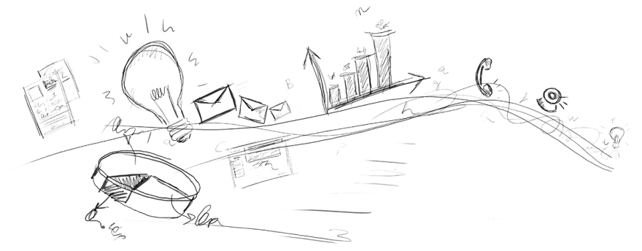
Intro to Ethereum
Mike Rosack
mrosack@gmail.com
github.com/mrosack

Slide 2

Quick Intro
About me – Excited about blockchain tech, haven’t done anything userful with it
Ethereum just recently became “stable”, but a lot of the tooling is still very primitive
Killer app hasn’t been written yet, and maybe not even dreamed of yet
Please ask questions!

Slide 3
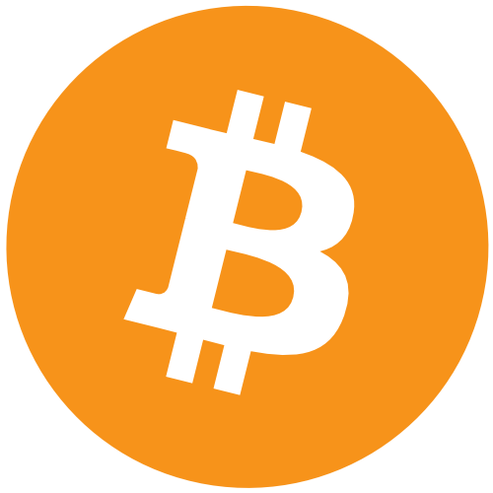
Bitcoin introduced the Blockchain to the world…
But what really is a blockchain?

Slide 4
Shared Ledger
Global peer-to-peer network
Decentralized – no one controls the network, no one needs to be trusted
Transparent – every member of the network can see every transaction
Anonymous (but not untraceable)

Slide 5
Blocks
A “block” is a group of transactions, anyone can submit a transaction to the network to be included in a block
Blocks are “mined” by a network of “miners” competing to find a hash of all the transactions in the block with an appropriate number of leading zeroes (“proof of work”), once network agrees that a block is valid work begins on the next block
Difficulty is adjusted to target a stable block generation time (15 minutes for Bitcoin)
The hash of the previous block is included in the current block, creating the “chain”. Because of this it’s impossible to forge any block without forging them all!

Slide 6
Accounts (“Wallets”)
An account is simply a public/private key pair
To submit a transaction to the blockchain, it must be signed with the private key of the account
Obviously, losing your private key or having it stolen is irrecoverable
Transactions are validated by miners so you can’t just send anything to the chain

Slide 7
That’s Great! But…
Bitcoin solved a very specific case of what blockchains could be used for.
Bitcoins can be transferred without having to trust anyone, but what if you want to conditionally send bitcoins? Who do you trust to escrow?
A global shared ledger is useful far beyond financial transactions:
Transparent voting / decentralized organizations
Notarization (proof of ownership)
Prediction markets
IOT

Slide 8
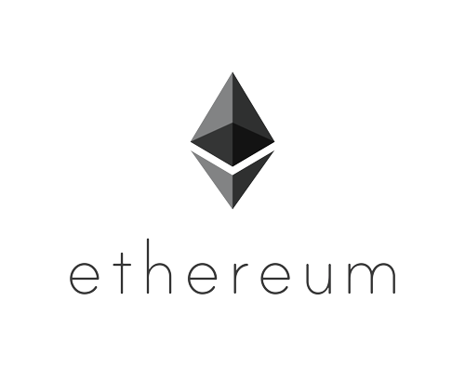
Introducing Ethereum
Turing complete blockchain: allows “Smart Contracts” to run on the blockchain
Integrates well with Javascript, allowing development of Ethereum-based web applications
15 second block time target

Slide 9
But why do we need Ethereum?
Can’t we just extend Bitcoin?
People have been having this argument since Etherem was announced…
Bitcoin does have a scripting language, but it’s not fully turing complete
Lots of people are working on using Bitcoin “sidechains” to implement smart contracts (Counterparty is the most mature, Rootstock is the new hotness)
It may one day be just as easy to do smart contracts with Bitcoin as it is with Ethereum, but that day isn’t today, and Ethereum is here already!

Slide 10
How does Ethereum prevent overuse?
Gas!
Every operation performed in a smart contract costs “gas”
The price of gas is variable, contracts specify how much they’re willing to pay for gas and miners can set how much they’ll accept
Currently the price of gas is 2/100,000,000 of an ether, but transactions can routinely take 100k gas.
Storing data on the blockchain also costs gas, storing a lot of data is prohibitively expensive

Slide 11
What are some examples of Ethereum Applications?
http://dapps.ethercasts.com

Slide 12
What is an Ethereum App (DApp)?
Code is written in a highish level language called Solidity, compiled to bytecode.
Bytecode can be included in a network transaction, this turns it into a smart contract
Contracts can call other contracts, and you can also send a transaction to the network to call a contract without any other bytecode
You can also reference local methods on contracts without making transactions on the blockchain
You can create HTML / Javascript front ends to interact with contracts and send new transactions to the blockchain

Slide 13
How are DApps Deployed?
The ideal situation would be for all users to have a copy of the blockchain locally, but just as with Bitcoin that’s not feasible for end users
If the end user has a local blockchain, they can host a RPC service that DApps would connect to to make blockchain requests
For websites, you could act as a gateway to the blockchain for the end user, but that would mean read-only blockchain access (unless you want to foot the bill for transactions)
Optimal scenario would be light wallets – the ability to sign transactions from your private key securely without having a full local chain. Tools like Metamask are aiming to solve this problem.

Slide 14
So, how do I write a DApp?
Mix IDE: Graphical development environment for Ethereum, user friendly but buggy and unstable
Truffle: Ethereum Web App Framework, support for testing contracts and deploying to multiple Ethereum clients
Visual Studio! Microsoft has been making a push to have Azure be friendly to blockchain applications, a project type was announced at Build 2016, but it’s not at all ready for prime time.

Slide 15
DEMO
Mix IDE

Slide 16
DEMO
Truffle

Slide 17


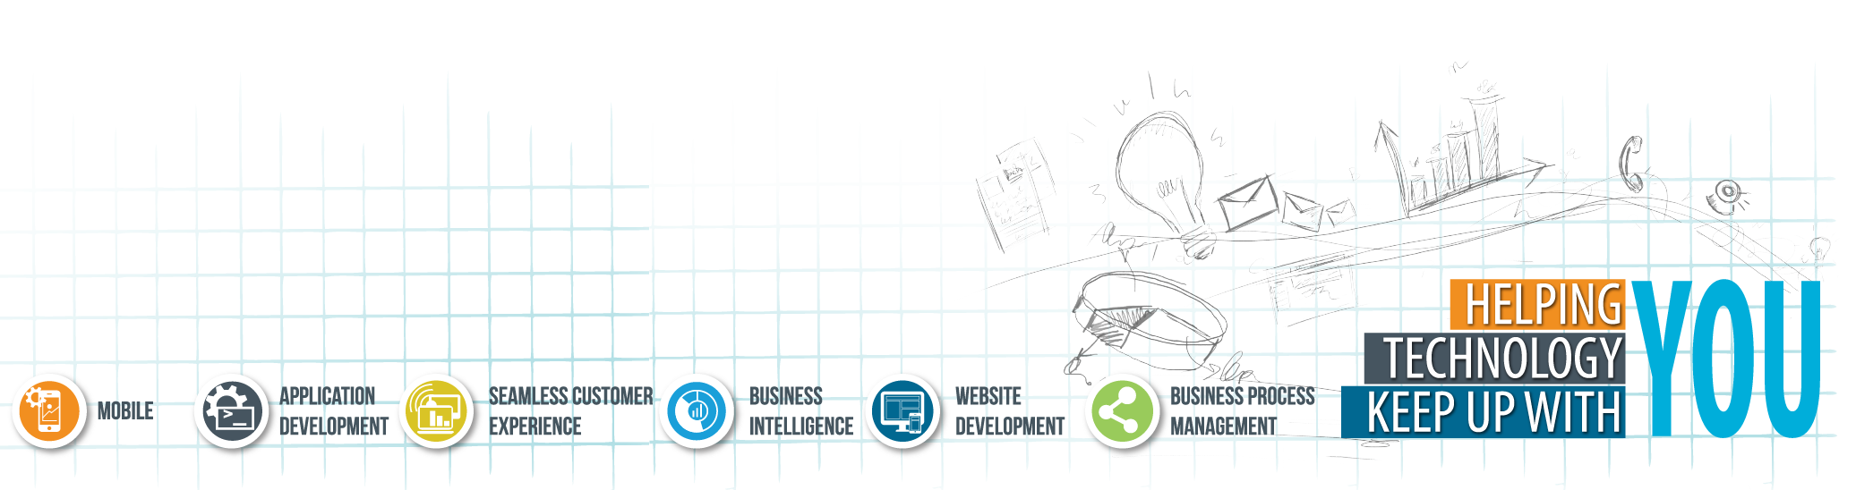
APPLETON/GREEN BAY
4351 College Avenue Suite 210 Appleton, WI 54914
MADISON
5250 East Terrace Drive
Suite 130 Madison, WI 53718
Thank you!
MILWAUKEE
2367 N. Mayfair Road
Suite 200 Wauwatosa, WI 53226

